Slide 1
What should we worry about when we worry about housing problems?
Inaugural lecture
Rebecca Tunstall
Director, Centre for Housing Policy, University of York
Joseph Rowntree Professor of Housing Policy
Becky.tunstall@york.ac.uk
30th April 2012

Slide 2

sweets

Slide 3
Introduction
3
There are strong arguments for worrying about housing consumption in relative rather than absolute terms, where data and measures allow
This lecture presents a case study of relative housing consumption, measured via housing space
Using a long-term perspective, and relative measures, it argues that:
We need to reassess assumptions about past achievements on overcrowding
Housing space inequality are similar to inequalities in income, and by some measures are growing
New space supply and demand problems appear to have emerged over the past 30 years
Current policy will exacerbate inequalities, and old-fashioned absolute problems are on the increase.

Slide 4
An experiment...
4
Place A | Place B
The average home has 6 rooms Your new home has 3 rooms | Your new home has 2 rooms The average home has 1 room

Slide 5
Absolute housing space standards
5
‘Overcrowding’
Households with fewer than 0.5/1/1.5 rooms per person (C19th-)
‘Bedroom standard’ (1960-)
A bedroom for:
Each married/cohabiting couple;
Any other person aged 21+;
Any pair aged 10-20 of the same sex;
Any pair aged under 10.
Basis fore most social rented allocations today (Pawson et al. 2009)

Slide 6


Slide 7
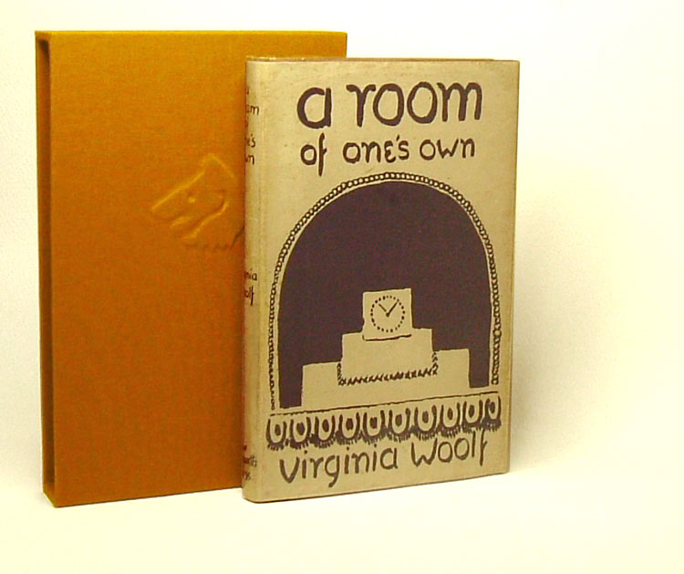

Slide 8
Arguments for worrying about housing space consumption in relative terms
8
More socially just?
Relative standards accepted by experts and public for income; no reason not to apply to consumption too
Housing appears to be partly a ‘positional good’ (Bramley et al. 2008, Marsh and Gibb 2011)
Housing is important in social science partly because of role of housing inequality in stratification (Rex and Moore 1967, Bell 1977, Saunders 1990, Hamnett 1999, Malpass 2005)
Current absolute standards challenged:
  “very low… now generally accepted as being completely unacceptable” (ODPM 2004 npn)

Slide 9
Data and measures used here
9
Census of population, 1911-2001
England and Wales
‘Rooms’ = “count the kitchen as a room, but do not count scullery, landing, lobby, closet, bathroom, nor warehouse, office, shop” (GRO 1913 p2).
1-bed flat with kitchen and living room = 3 rooms
3-bed house with kitchen, 2 living rooms = 6 rooms
Does not account for room size or type
Applied to individuals not households
Treats all individuals the same way: no equivalisation
Excludes ‘non household’ population
Excludes second homes
No 2011 data yet

Slide 10
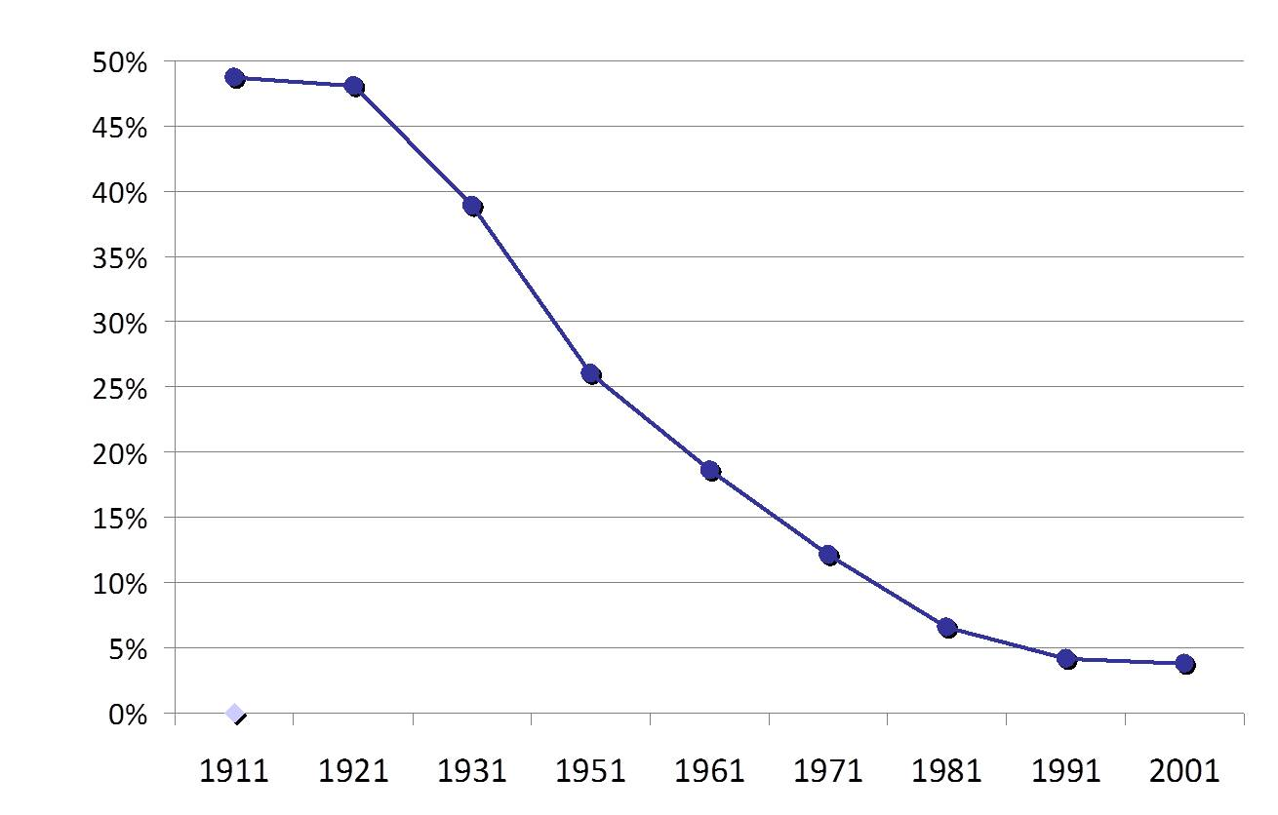
Absolute low consumption
- ‘overcrowding’ – fell dramatically
Percentage of people in households with less than one room per person, England and Wales, 1911-2001

Slide 11
Median housing space per person rose steadily
Rooms per person

Slide 12
But experiences varied across the population
Rooms per person by population decile

Slide 13
There was no change in housing space inequality according to the Gini measure

Slide 14
Ratios show falling and then rising inequality

Slide 15
Percentage of people below 60% median space shows the same trends

Slide 16
Potential causes of rising housing space inequality
16
Household-home size mismatch
Blockage of ‘trickle down’ of space
Income inequality?
Tenure change?

Slide 17
Increasingly, small households were well-housed due to a deficit of smaller homes
1-person households with 4+ rooms

Slide 18
The best-housed gained more from new development, especially after 1991
Percentage of net additional rooms held by different groups

Slide 19
Housing space inequality shows similar trends to income inequality
90:10 and 50:10 ratios

Slide 20
Is there a link between relative housing space and housing tenure?
Tenure composition of fifths of population by housing space, 2001

Slide 21
Potential consequences of rising inequality
21
Reduced happiness, well-being?
Sustained or increased absolute low consumption?
Implications:
Monitoring via relative standards
New development?
Redistribution?

Slide 22
Potential relative housing space standards
22
‘Low relative housing space consumption’ standard:
Below 60% median housing space
In 2001, below 1.9 rooms per person - generally above bedroom standard
‘Consensual’ standard (Bradshaw et al. 2008):
Pensioner couple – 2 bedrooms - bedroom standard +1
All children – own room - probably above bedroom standard

Slide 23
23
The 1960 bedroom standard is “now generally accepted as being completely unacceptable” (ODPM 2004 npn)
It places most individuals:
In worst housed fifth for 2001
Below 60% median space
Below consensual standard
At what median person had achieved by 1921

Slide 24
The strange re-emergence of the politics of housing space
24
New space policies:
The single room rent and extension – puts people below the bedroom standard
The ‘benefit cap’ – may be at/below bedroom standard
The ‘bedroom tax’ – at bedroom standard
Significant reduction in welfare rights
Regressive redistribution of space?
Likely to result in increase in old-fashioned overcrowding

Slide 25
Conclusion
25
There are strong arguments for worrying about housing consumption in relative rather than in absolute terms, where data and measures allow
Relative measures suggest:
We need to reassess assumptions about past achievements on low housing space: overcrowding could have been reduced faster
Housing space inequality are similar to inequalities in income, and by some measures are growing
New structural space supply and demand problems appear to have emerged over the past 30 years: size mismatch, trickle down blockage
Current policy will exacerbate inequalities, and old-fashioned absolute problems may be on the increase.

Slide 26
References
26
Bell, C. (1977), ‘On housing classes’ Journal of Sociology 13(1):36-40
Bradshaw, J.; Middleton, S., Davis, A., Oldfield, N., Smith, N., Cusworth, L., and Williams, J, (2008), A minimum income standard for Britain: What people think, York, JRF
Bramley, G., Leishman, C. and Watkins, D. (2008) Understanding neighbourhood housing markets: regional context, disequilibrium, sub-markets and supply; Housing Studies 23(2) pp179-212
Hamnett, C. (1999), Winners and losers: Home ownership in modern Britain, London, UCL
Malpass, P. (2005), Housing and the welfare state: The development of housing policy in Britain, Basingstoke, Palgrave Macmillan
Marsh, A and Gibb, K (2011) ‘Uncertainty, expectations and behavioural aspects of housing market choices’, Housing, Theory and Society, 28(3), pp215-235
Office of the Deputy Prime Minister (2004), Overcrowding in England: The national and regional picture: Statistics, London, ODPM
Pawson, H., Brown, C. and Jones, A. (2009) Exploring local authority policy and practice on housing allocations, London: Communities and Local Government
Rex, J. and Moore, R. (1967), Race, community and conflict: A study of Sparkbrook, Oxford: Oxford University Press
Rowntree, B. S. (1901), Poverty: A study of town life, London, Macmillan and Co.
Rowntree, B. S. (1985), Poverty and progress, New York, Garland Publishers
Saunders, P. (1990), A nation of home owners, London, Allen and Unwin
Stephens, M., Fitzpatrick, S., Elsinga, M., van Steen, G., and Chzhen, E. (2010), Study on housing exclusion: Welfare policies, housing provision and labour markets, Brussels, European Commission
Woolf, V. (1991), A room of one’s own London, Hogarth Press.

Slide 27
27
For more information:
www.york.ac.uk/chp
Becky.tunstall@york.ac.uk

